Slide 1
SYNOD Listening Session

Slide 2
OPENING PRAYER
We stand before You, Holy Spirit, as we gather in Your name.
With You alone to guide us, make Yourself at home in our hearts.
Teach us the way we must go and how we are to pursue it. We are weak and sinful; do not let us promote disorder.
Do not let ignorance lead us down the wrong path nor partiality influence our actions.
Let us find in You our unity so that we may journey together to eternal life and not stray from the way of truth and what is right.
All this we ask of You, who are at work in every place and time, in the communion of the Father and the Son, forever and ever.
Amen.

Slide 3
INTRODUCTIONS
Please introduce yourself.
Say your name and tell the group a little about yourself.

Slide 4
INTRODUCTORY VIDEO
In this brief introduction video, Bishop Soto & Sister Karla will introduce your group to the listening session process.
English (5:08): https://vimeo.com/638261331/80360291bd
Spanish (6:13): https://vimeo.com/638262089/45c735d772

Slide 5
GROUND RULES
Prayer
Respect
Trust
Listening
Sharing
Discernment

Slide 6
Matthew 14:13-21
When Jesus heard of it, he withdrew in a boat to a deserted place by himself. The crowds heard of this and followed him on foot from their towns. When he disembarked and saw the vast crowd, his heart was moved with pity for them, and he cured their sick. When it was evening, the disciples approached him and said, “This is a deserted place and it is already late; dismiss the crowds so that they can go to the villages and buy food for themselves.” [Jesus] said to them, “There is no need for them to go away; give them some food yourselves.” But they said to him, “Five loaves and two fish are all we have here.” Then he said, “Bring them here to me,” and he ordered the crowds to sit down on the grass. Taking* the five loaves and the two fish, and looking up to heaven, he said the blessing, broke the loaves, and gave them to the disciples, who in turn gave them to the crowds. They all ate and were satisfied, and they picked up the fragments left over*—twelve wicker baskets full. Those who ate were about five thousand men, not counting women and children.

Slide 7
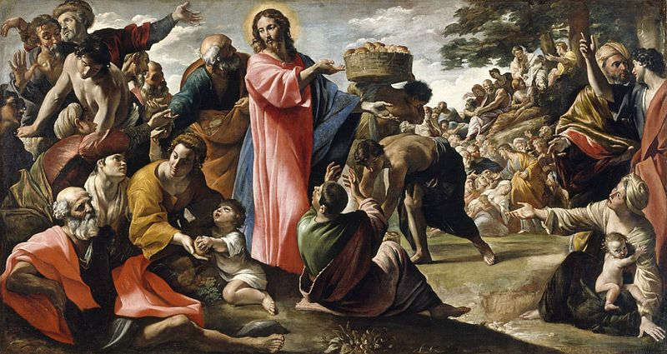

Slide 8
Question #1
Reflecting on the image – what experiences of church come to your mind that are life giving?

Slide 10
Question #2
What do you bring to this encounter with Jesus that is burdening and challenging?

Slide 12
Question #3
Where do you sense the Spirit is leading you to grow more deeply, to engage more fully?

Slide 14
Question #4
After we heard all this: What touches you the most? What begins to emerge? What is the most significant moment for you?

Slide 16
Next Steps
Note taker will submit the notes from this session to the Diocese.
Diocesan Pastoral Council, Deacon Council, Presbyteral Council and Diocesan Staff will review all the notes.
10 page summary of the diocesan listening sessions will be submitted to the US Bishops Conference

Slide 17
Closing Prayer
Come Holy Spirit, fill the hearts of your faithful and kindle in them the fire of your love. Send forth your Spirit and they shall be created. And You shall renew the face of the earth. O, God, who by the light of the Holy Spirit, did instruct the hearts of the faithful, grant that by the same Holy Spirit we may be truly wise and ever enjoy His consolations, Through Christ Our Lord, Amen.

