Slide 1
Journey to Mission
An RCIA Virtual Retreat

Slide 2
GoaL:
Proximate spiritual preparation for the Sacraments of Initiation during the time of the Covid-19 pandemic. To re-focus their minds and hearts as they prepare to become children of God and members of the Body of Christ in Baptism, receive the Gift of the Holy Spirit in Confirmation, and receive His precious Body, Blood, Soul, and Divinity in the Holy Eucharist- in order to go out into mission in the world.

Slide 3
Underlying Theme
Becoming Catholic (or completing your Sacraments of Initiation) is not the “end goal.” You are not “done.” The reception of the Sacraments of Initiation is the beginning of your new life in Christ and your mission with Him and with us- in His Church and in the world.

Slide 4
Retreat Introduction
Romans 8:25 “…if we hope for what we do not see, we wait with endurance.”
These words spoken by St. Paul to the Romans, aptly apply to you RCIA elect and candidates who have been waiting with endurance since the Covid-19 pandemic caused our lives to change abruptly during Lent.
At the Rite of Election on Feb. 29 and Mar.1, either Bishop Soto or Bishop Weigand declared you who are unbaptized to be “members of the elect to be initiated into the sacred mysteries at the coming Easter Vigil,” when you were to receive Baptism, Confirmation, and Eucharist.

Slide 5
Continued…
For you candidates who are baptized and either waiting to be received into the fullness of the Faith or complete you Sacraments of Initiation, we recognized “your desire to be sealed with the gift of the Holy Spirit and to have a place at Christ’s Eucharistic table” and we exhorted you to “hear the Lord’s call to conversion and be faithful to your baptismal covenant.”
Easter Vigil has come and gone, and still you wait with endurance and hope for what you do not yet see.
As you move through this retreat in preparation to receive these holy Sacraments of Initiation, it’s important to emphasize that your journey does not come to an end once you’ve become Catholic and received the sacraments. In fact, your journey up to this point has been preparing you to begin! With your reception of the sacraments you will begin to live your new life in Christ by serving as His disciples in mission together with all of us in the Body of Christ

Slide 6
Continued…
We are baptized not only into our Lord’s life, but also into His mission. Your mission field will be that of your families, work places, parishes, communities, and wherever He takes you. God will work through you, His disciples, as His instruments to bring others into relationship with Him. He will give all the grace needed for the unique mission He has for each one of you, and the majority of that grace will come from the sacraments He instituted in the Catholic Church.
Ask the Lord to guide you, His chosen ones and to strengthen you in your vocations as you build the kingdom of God. Prayers are being offered for you as you enter into this retreat in preparation to receive a share in the divine life of the Trinity in the sacraments of Baptism, Confirmation, and Eucharist.

Slide 7
Gathering Song
https://vimeo.com/424261514

Slide 8
Scripture reading
https://vimeo.com/421759302
Matthew 16:13-17
You are the Christ
Reflection on Creed
Presentation of Creed #160
Prayer #161

Slide 9
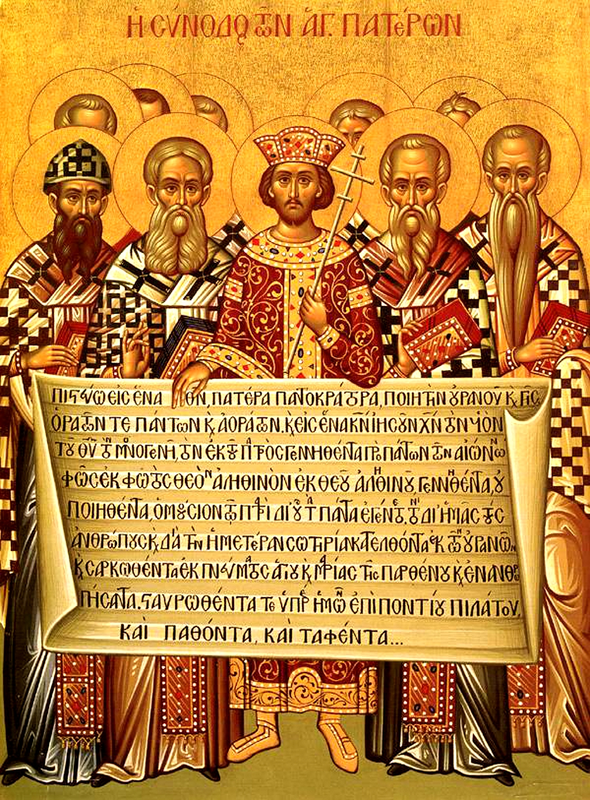
Invitation to Reflect and Share
Think, Reflect, Pray, or Write
Share with your groups
The Creed

Slide 10
When Jesus asked his disciples, “who do people say that I am?”, there were many responses. Then Jesus asked, “Who do YOU say that I am?” What is your answer to that question.
What reality is the Profession of Faith based on?
There are many points professed in the Creed… which point resonates with you the most?
Points for you to Ponder
The Creed
I Believe in One, Holy, Catholic, and Apostolic Church

Slide 11
Scripture Reading
Scripture Reading
Mark 7:31-37 Be Open
Reflection on
Ephphetha Rite #197

Slide 12
Scripture Reading:
https://vimeo.com/424262317
Matthew 6:9-13
Brief Reflection of Our Father
Closing Prayer #182

Slide 13
Confirmation
https://vimeo.com/421764200
Isaiah 11:1-2 Confirmation
Call to use the 7 Gifts (Charisms) Reflection

Slide 14
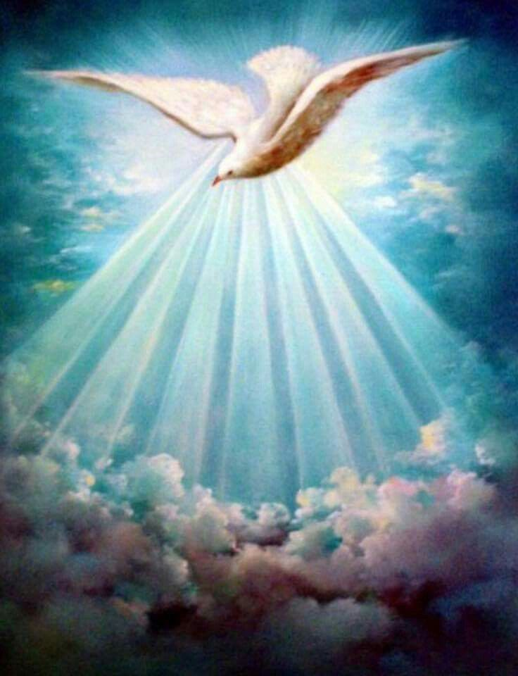
Invitation to Reflect and Share
Think, Reflect, Pray, or Write
Share with your groups
The Holy Spirit

Slide 15
Using a situation you have recently experienced, how could you have used any (or all) of the Seven Gifts to respond to the situation in order to build the Kingdom of God by helping those involved to meet the Risen Lord through you?
(You may find the attached handout on the Seven Gifts helpful as you reflect.)
The Holy Spirit
Points for you to Ponder
The Seven Gifts of the Holy Spirit that you will receive at your Confirmation are:
Wisdom, Understanding, Knowledge, Counsel, Fortitude, Piety, and Fear of the Lord.

Slide 16
Write a sentence or two about how you think God might be using you now, or how he might use you in the future to build His Kingdom.
Have you noticed any ways in which God might have used you to bring Him to others in your life so far? If so, write a sentence or two about an experience you can think of where you have responded to His call.
The Holy Spirit
Points for you to Ponder
The Seven Gifts of the Holy Spirit that you will receive at your Confirmation are:
Wisdom, Understanding, Knowledge, Counsel, Fortitude, Piety, and Fear of the Lord.

Slide 17
Letter/Prayer to God
https://vimeo.com/421766703

Slide 18
Exposition
https://vimeo.com/421769463
1Cor 11:23-26
Communion Reflection

Slide 19
Closing Prayer
https://vimeo.com/424262317
Holy Spirit
St. Augustine

